Slide 1
Intro To FTC Maching Learning
(TensorFlow and Vuforia)

Slide 2

Topics for today
What is TensorFlow?
  And Vuforia ☺
Current Season Challenges
Demo of Freight Frenzy TensorFlow sample code
Sample Code – details
Helpful Hints for Successful Implementation
Custom Team Shipping/Scoring Element

Slide 3
FTC Machine Learning TensorFlow
TensorFlow is an open source Google Machine Learning framework
  TensorFlow Lite is a version of TF designed to run on Android phones
  TF is designed to visually recognize “things” based on models contained in its bank of stored models
  TF Models are created by a process of using AI on multiple images
  It has the ability to report finding models it detects, along with a confidence factor.

Slide 4
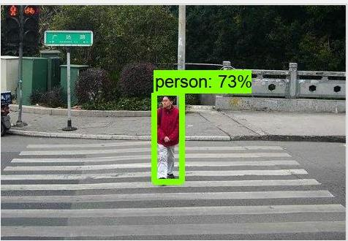
TensorFlow Examples

Slide 5
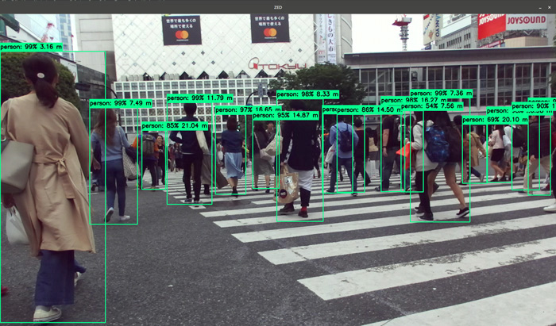
TensorFlow Examples

Slide 6
FTC Machine Learning - Vuforia
Vuforia is an Augmented Reality (AR) image technology for mobile devices
It uses computer vision technology to recognize and track planar images and 3D objects in real time

Slide 7
FTC Machine Learning
FTC has implemented a Vuforia overlay on the phone camera video stream for two main purposes:
  For using the native Vuforia application to detect and track Vumark 2D images on the field.
    To assist robot localization (position of robot on field)
  To detect TensorFlow objects on the field, and use Vuforia to report the position of those objects on the field
    To make decisions on what robot actions should be taken to maximize points

Slide 8
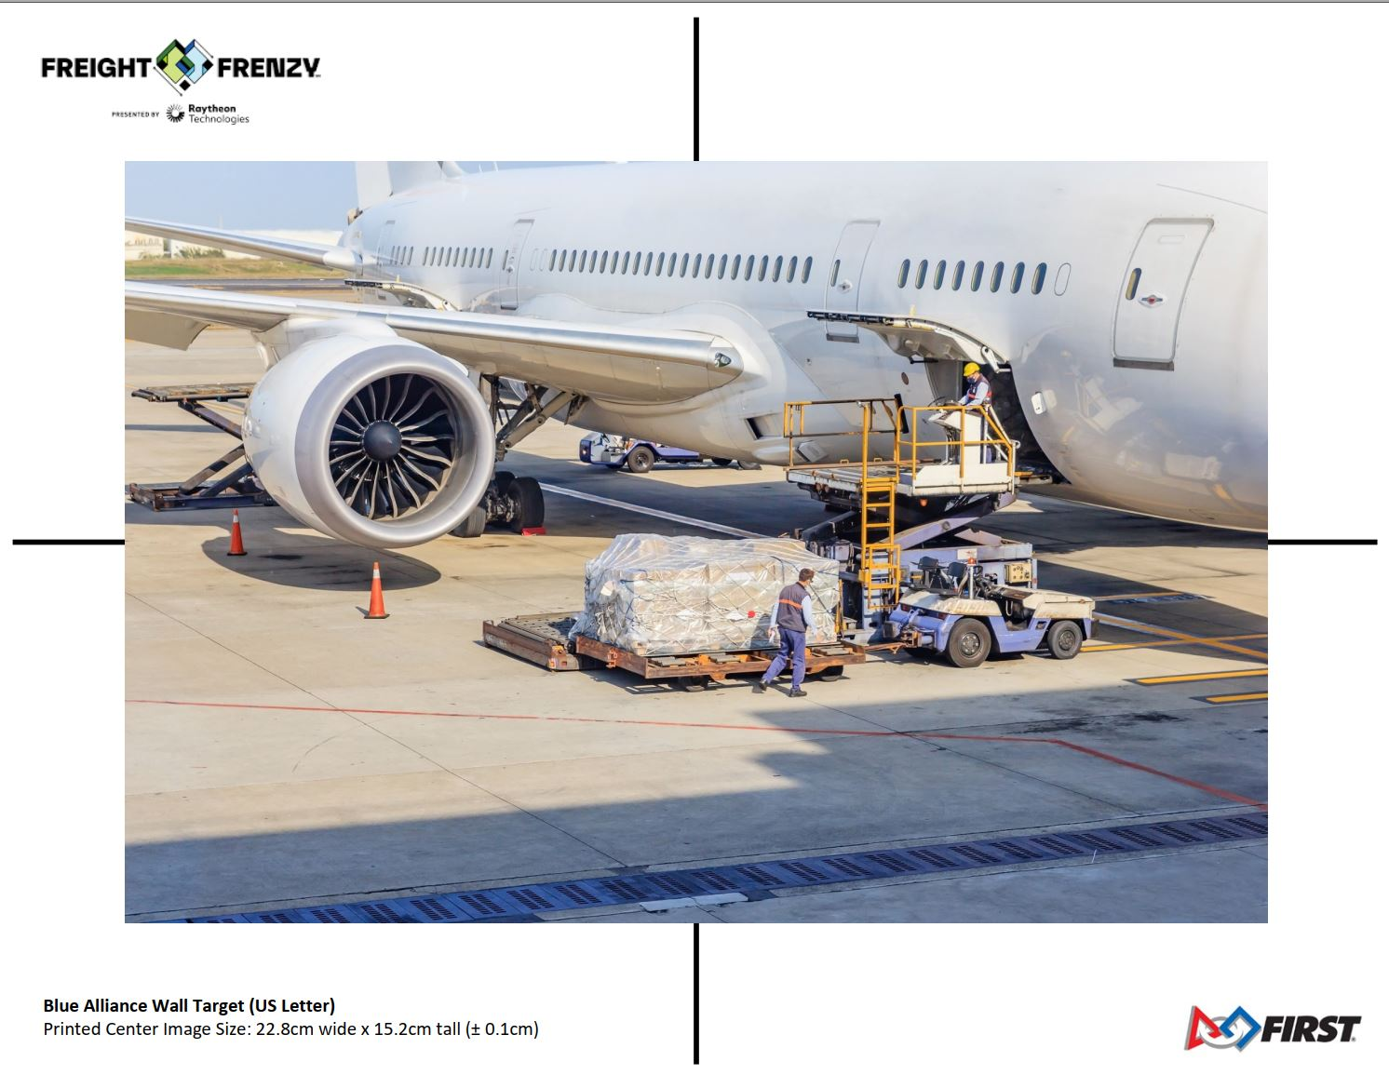
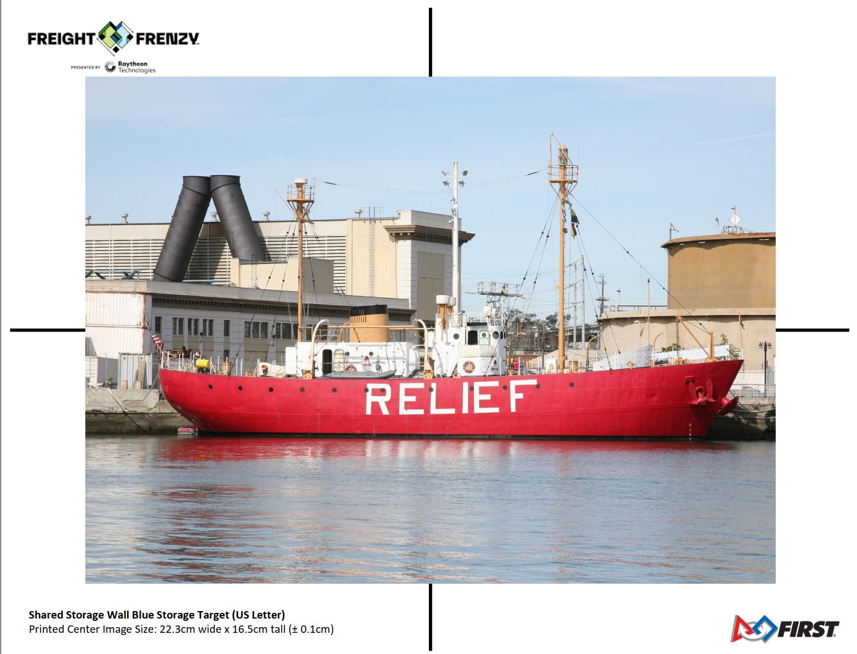
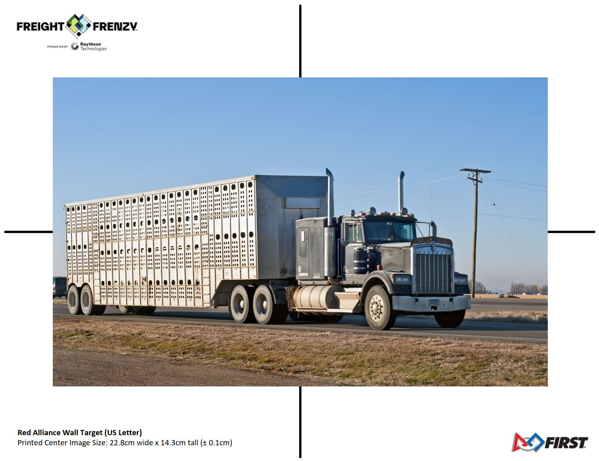
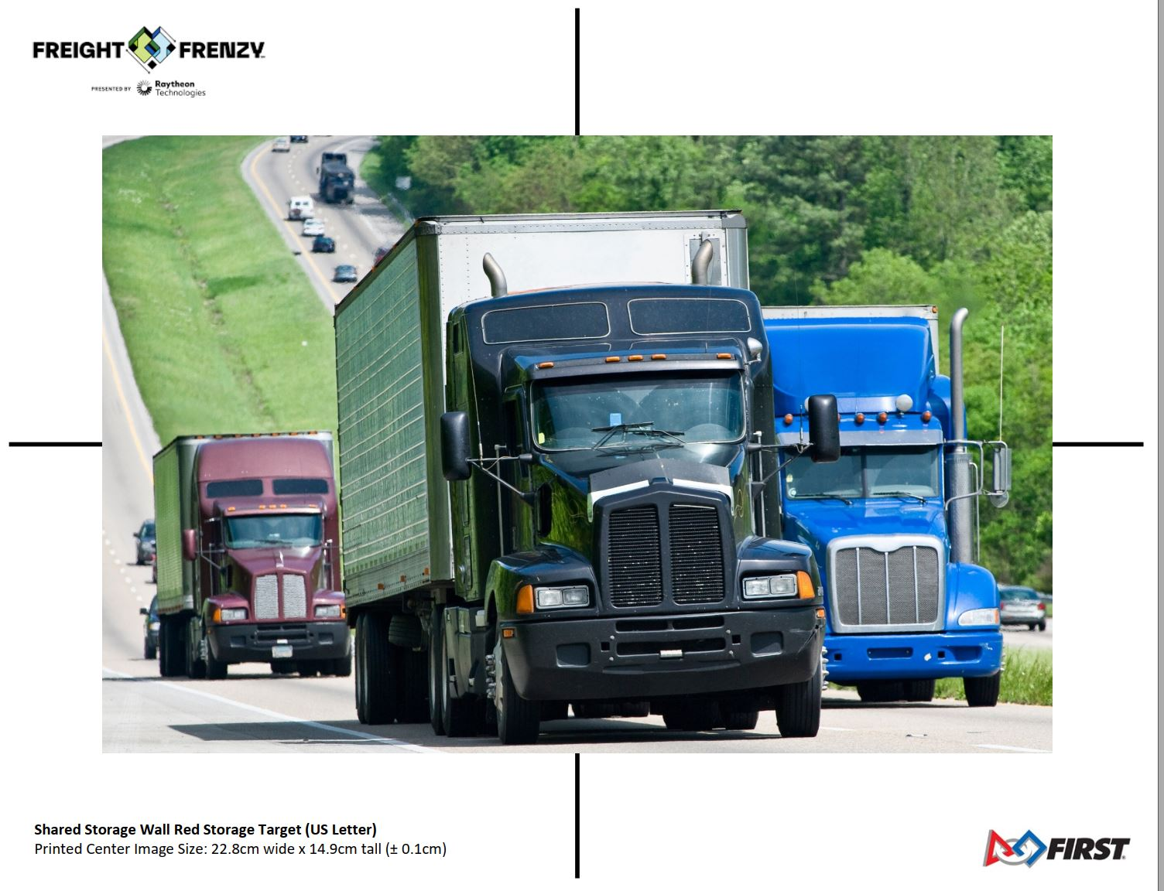
Freight Frenzy VuMarks

Slide 9
Summary of FTC Machine Learning Tools and Purposes
Vuforia:
  Basic framework for vision processing
  Main use is robot navigation on field
TensorFlow:
  Object recognition
  Main use is to adapt your robot actions to achieve more points!

Slide 10
Using TF for Freight Frenzy
Question:
What successful autonomous task achieves the highest point award?

Slide 11
Using TF for Freight Frenzy
Answer:
Delivering pre-loaded game element to the proper Alliance Shipping Hub level corresponding to the position of a team’s custom Team Shipping/Scoring Element on the barcode.
Achieves 26 points! (6 points + 20 point Bonus)

Slide 12
How do you achieve this?
TensorFlow!
  (Caveat- in order to detect your custom team element, you will need to create your own custom TF model! We will discuss this as the last topic)
What is the next best thing?
  You can score 16 points (6 + 10 bonus points) by delivering the pre-loaded element to the Alliance Shipping Hub level corresponding to the position of the Rubber Duck on the barcodes
TensorFlow Rubber Duck models exist today

Slide 13
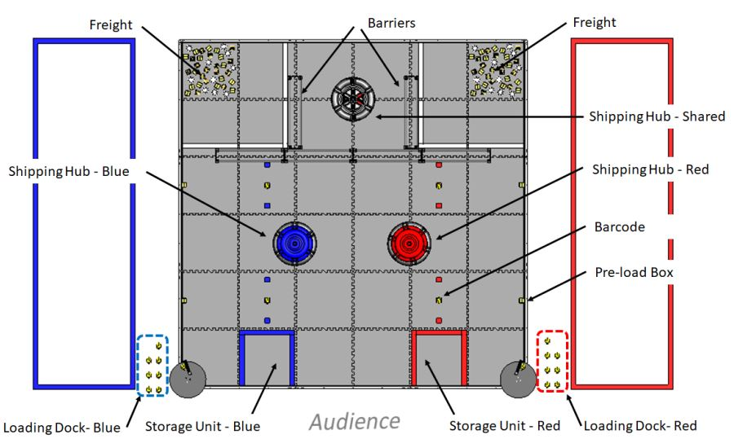
Field setup/Description
At robot placement, a rubber duck is placed in the middle barcode element for each team
Before Start, the position of the duck on the barcode is randomized
Teams can elect to replace the rubber duck with their Custom Team Shipping Element

Slide 14
Basic concept for setup and programming
Position robot on field with phone camera (or webcam) facing barcodes
Upon initialization and start, use TF/Vuforia to detect which barcode has the rubber duck (or Team Element)
Have three branches of your code
  If duck is on #1, program drives robot to Alliance Hub and place pre-loaded box on Level #1
  If duck is on #2, drive robot to Alliance Hub and place pre-loaded box on Level #2
  If duck is on #3, drive robot to Alliance Hub and place pre-loaded box on Level #3

Slide 15
Getting Started
FTC has included a sample program called ConceptTensorFlowObjectDetection
This program can easily be adapted for use in your Autonomous program

Slide 16
TensorFlow Demo

Slide 17
First time setup of the sample TF code
Need to obtain Vuforia License Key from the Vuforia website:
  https://developer.vuforia.com/license-manager
  Need to create account (free) and login first
Once you obtain the Vuforia Key, copy and paste it into the appropriate spot in the program

Slide 18
First time setup of the sample TF code
Other “tweaks” in the code:
  Confidence Factor
    Default is .8f
    Putting in larger number makes it more selective
    Smaller number is less selective
  Zoom factor
    Last years default value of 2.5 worked great, this year you need to cover larger area
    May need to revert to 1
    Other approaches may need other tweaks

Slide 19
Adapting the sample code- general strategy
The sample TF code will give you:
  Duck has been found
  Position of Duck in field of vision
Caution: The program can detect multiple models!
  Duck
  Marker (barcode)
  Ball
  Cube
Recommend you change the TF asset to only use the Duck and Marker:
  FreightFrenzy_DM.tflite

Slide 20
Adapting the sample code- general strategy
Psuedocode for general approach:
  Loop until you find a duck and note the position of the duck
  If the position of the duck is in the left third of the field, it is on #1 barcode
  If the position of the duck is in the middle of the field of image, it is on the #2 barcode
  If the position of the duck is on the right of the field of image, it is on the #3 barcode.

Slide 21
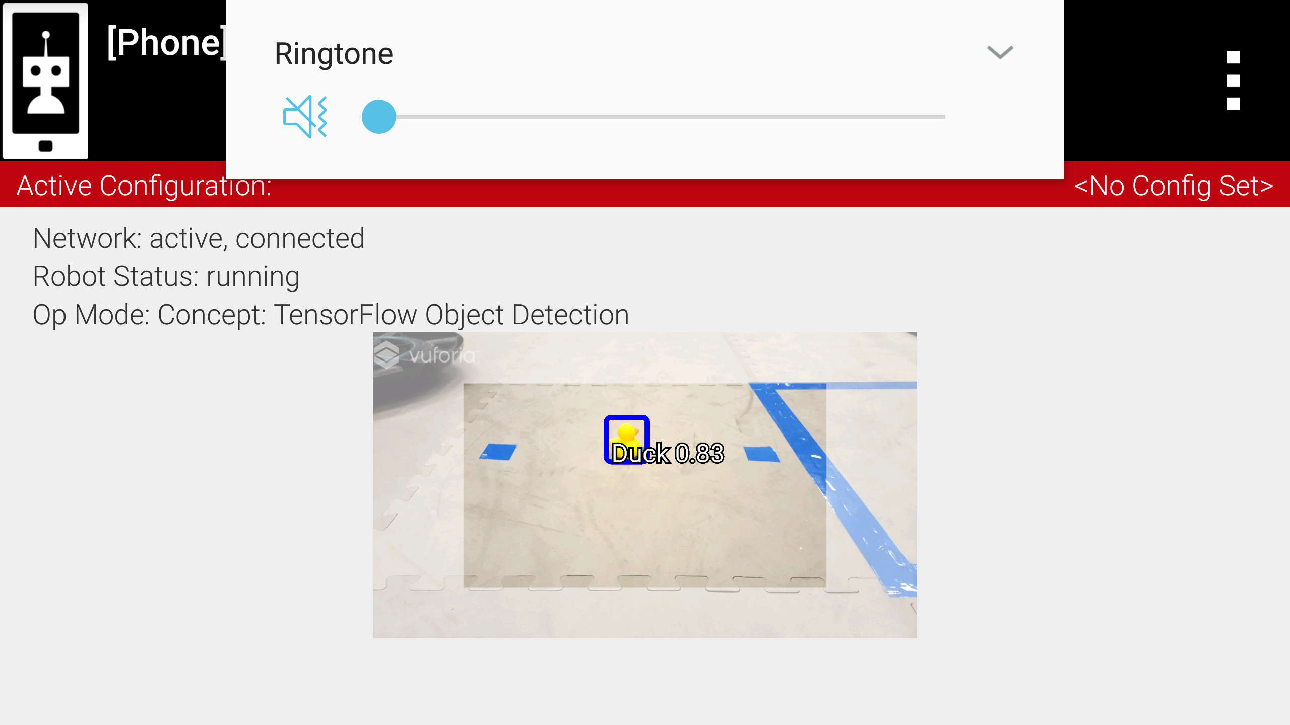
Adapting the sample code- general strategy
Problems with this approach:
  What if you cant find the duck?
  What if your camera doesn’t cover all three barcodes very well?

Slide 22
Adapting the sample code- general strategy
Possible solutions:
  Timed While loop
    Setup variables to run the loop for a maximum of maybe 1 second (1000 milliseconds)
    double duckTimeStart = runtime.milliseconds(); // Get the current time before entering the duck detect loop
    double duckIncTime =0;
    while (duckNotFound && duckTimeout) {
    TensorFlow recognition code here
    duckIncTime = runtime.milliseconds();
    if ((duckIncTime- duckTimeStart)>1000){ // This is the timeout value if TensorFlow doesnt see a duck
    duckTimeout = false; }
    }

Slide 23
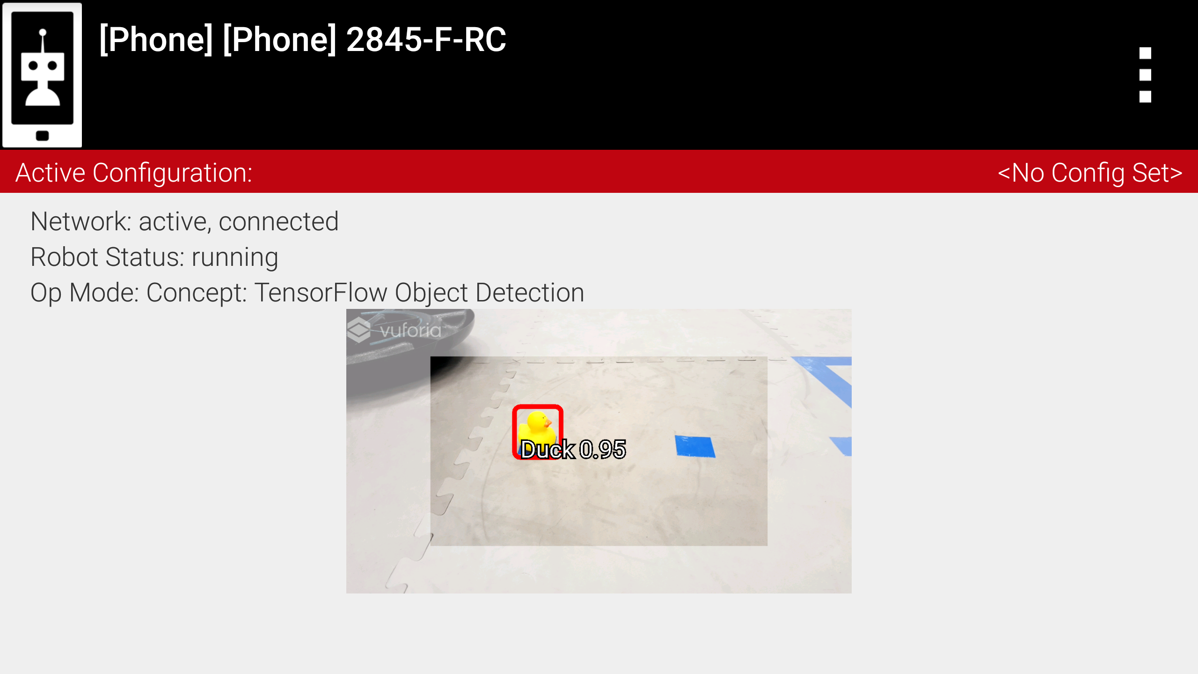
Adapting the sample code- general strategy
Other possibilities:
  Don’t try to see all three barcodes at once
    You only need to see two, if you cannot find the duck on the two barcodes you are looking at, since you already need a timeout function, you can assume that the duck is on the one you are not seeing if it times out

Slide 24
Adapting the sample code- general strategy
How to get “duck found” and “duck position”
  The following loop is where you extract the duck info:
  for (Recognition recognition : updatedRecognitions) {
  }
  Setup variable for duck position:
    double duckPosition;
  Setup test for duck found within the loop, and extract the position:
    if (recognition.getLabel()== “Duck"){
    duckPosition = recognition.getLeft(); // gets position of duck in pixels
    duckNotFound=false; // boolean flag to break out of loop
    }

Slide 25
Adapting the sample code- general strategy
How to translate duck position into one of the three barcode position:
  The getLeft position method gives you the X value in pixels of the left side of the model
  Typical screen pixels along the X axis is 1280
  0,0 origin of screen is upper left corner

Slide 26
Adapting the sample code- general strategy
How to translate duck position into one of the three barcode positions:
  Values of 0 to about 400 should correspond to #1
  Values ot 400 to about 800 should correspond to #2
  Values of 800+ should correspond to #3

Slide 27
Other points
  Use a fast phone!
    Early phones (like Moto 2nd gen) have trouble running TensorFlow
    Recommend Moto G5 or E5

Slide 28
Custom Team Shipping Element
Max bonus available by using custom team shipping element instead of duck
A custom TensorFlow model will need to be created and installed in your robot controller for this to work
  Very challenging programming to do on your own!
FTC Engineering has created a framework and apps to create an implement your own models
They will start beta testing this next week
Process will likely be as follows:
  Use FTC TF Model creation tool to create the tflite models
  Use tool to also upload custom model into your phone
  Adapt your program to use new model definitions

Slide 29
Custom Team Shipping Element
Other Advantage (besides high points):
  Team Element can be up to 4” X 4” X 8”, much bigger than the tiny duck
    Much easier for TF to detect it!
Recommend you consider TF recognition ability when designing your Team Element
  High contrast with field
  Simple shape

